Slide 1
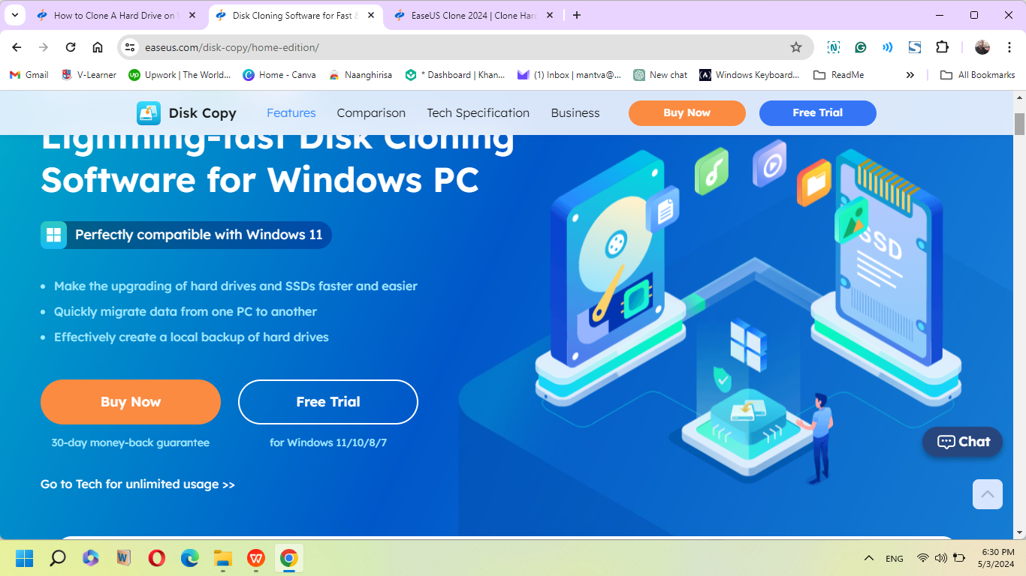
Cloning Disk C to Disk D
DISK CLONING
Hard drive cloning, also known as disk cloning or drive cloning, is the process of transferring and duplicating information from one computer hard drive to another. Hard drive cloning allows you to create an exact copy of your hard drive without any loss in the integrity of the data and software used during your day-to-day activities.
Reason for Cloning: Low Disk space, upgrading to a larger drive, or backup.

Slide 2
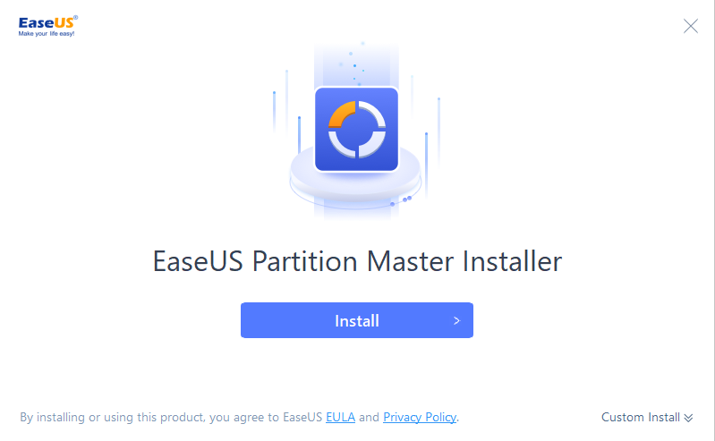
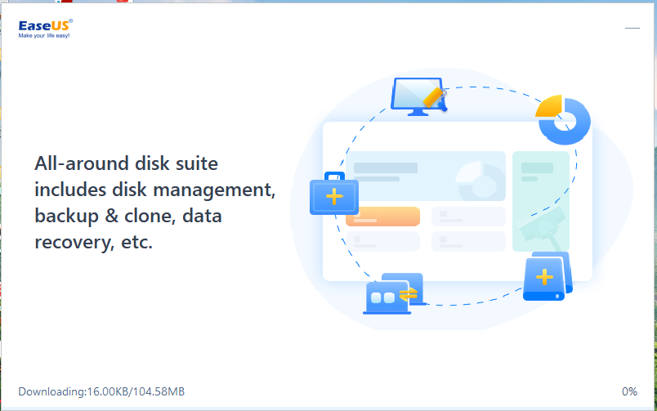
PREPARATION
IMPORTANT
Cloning will erase all data on Disk D, so I have to ensure it is empty or backed up
Backup and Downloading Software
I will backup important files on Disk C to an external drive or cloud storage
Download a reliable disk cloning software (I will use EaseUS Todo Backup for this task)
I will ensure Disk D is empty or backed up, as cloning will overwrite its contents

Slide 3
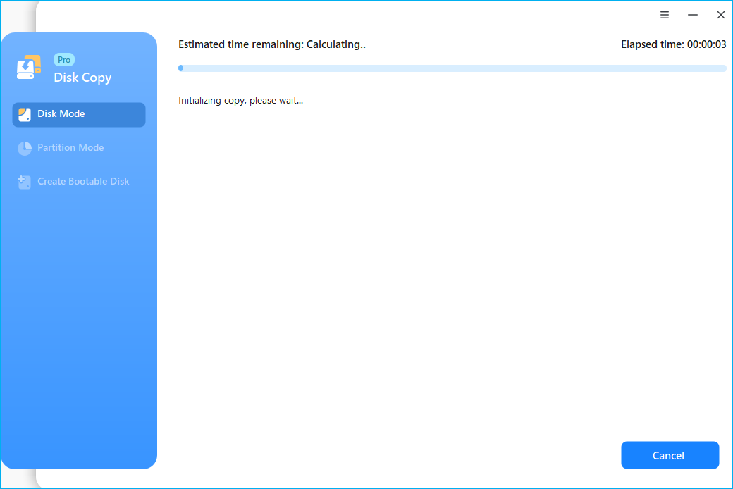
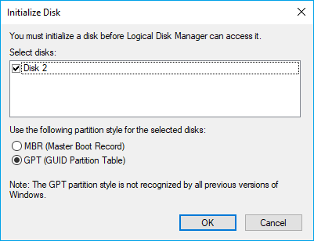
CLONING PROCESS
Step-by-Step Instructions
Initializing Hard Drive D
I will go to Disk Management, Check the partition style of the old disk, Right-click the disk and select "Properties" from the menu.
Connect hard drive to the computer via SATA Adapter cable or USB 3.0. Check if the new disk is shown on Disk Management. Right-click the HDD or SSD and Choose "Initialize Disk" from the menu. Set selected disk as MBR or GPT.
Clone Entire Hard Drive in Windows 11
Launching the cloning software and select “Clone” or “Disk Clone”
Selecting Disk C as the source disk and Disk D as the target Disk
Chooding the clone mode (e.g. sector-by-sector or intelligent clone)
Review the settings and start the cloning process
Waiting for the process to complete (This may take several hours)

Slide 4
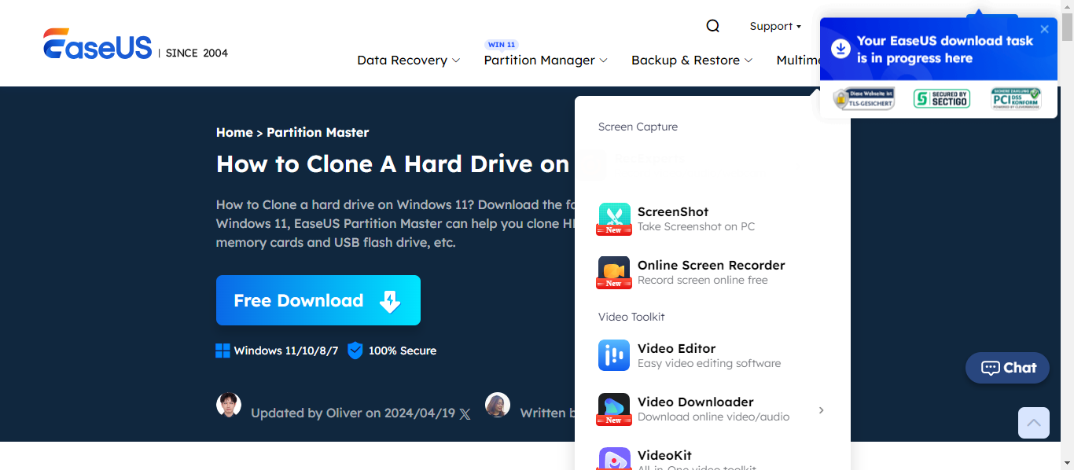
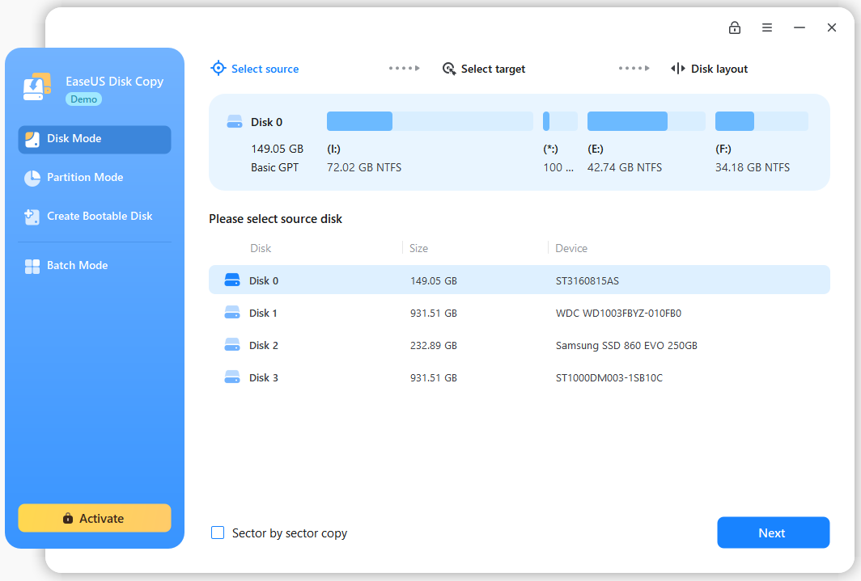
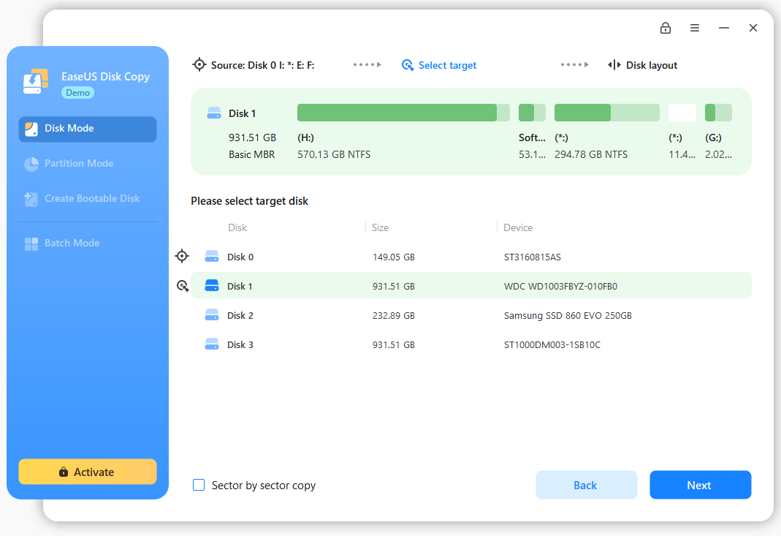
DEMONSTRATION
These screenshots are for demonstration of the process
EaseUS Todo Backup
Clone Option
Disk C and Disk D

Slide 5
COMPLETION AND VERIFICATION
Completing cloning with verification.
Ensuring all files, software nd settings are intact on Disk D
Verifying software licenses and activation status
Using Disk as the primary drive or keep it as a backup
Ullamcorper sit amet ligula. Nulla quis lorem ut libero malesuada feugiat. Vestibulum ac diam sit amet quam vehiculaullamcorper sit.

Slide 6

THANK YOU

